Slide 1
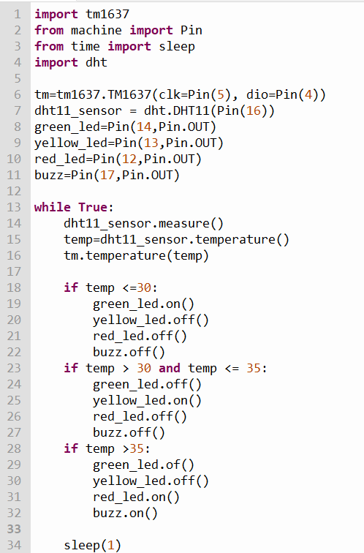
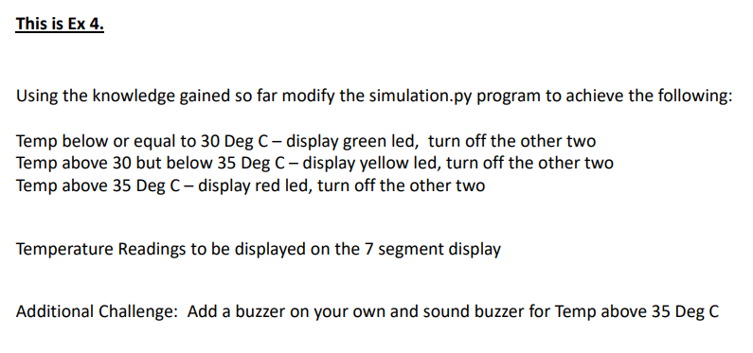
Libraries required for this project
Setting up the Components
The Algorithm for this project

